Slide 1


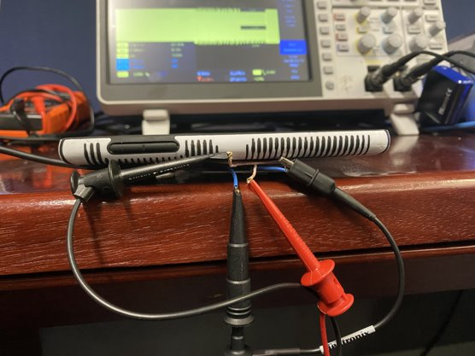
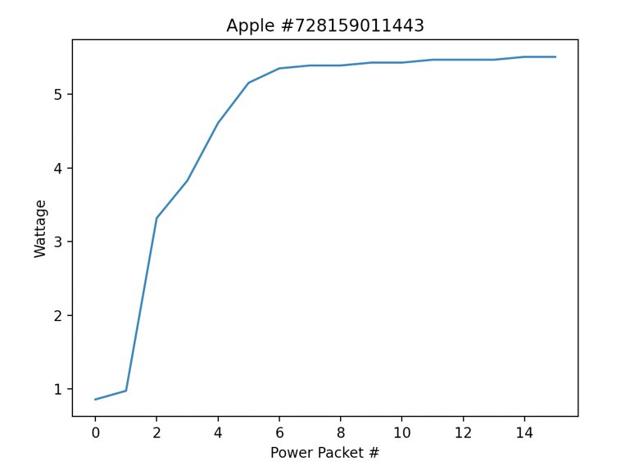
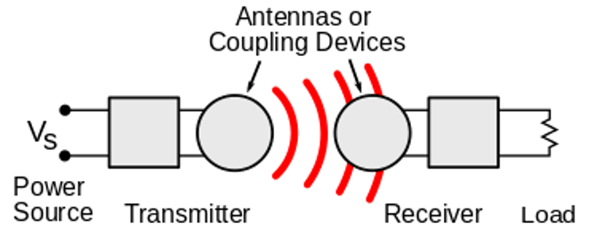
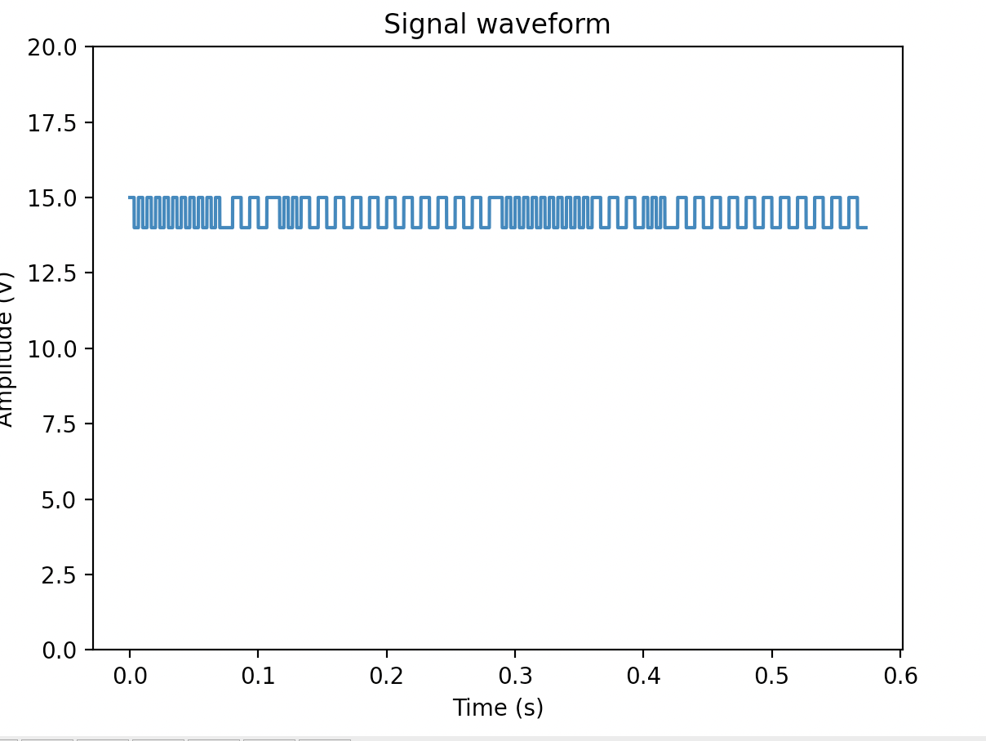
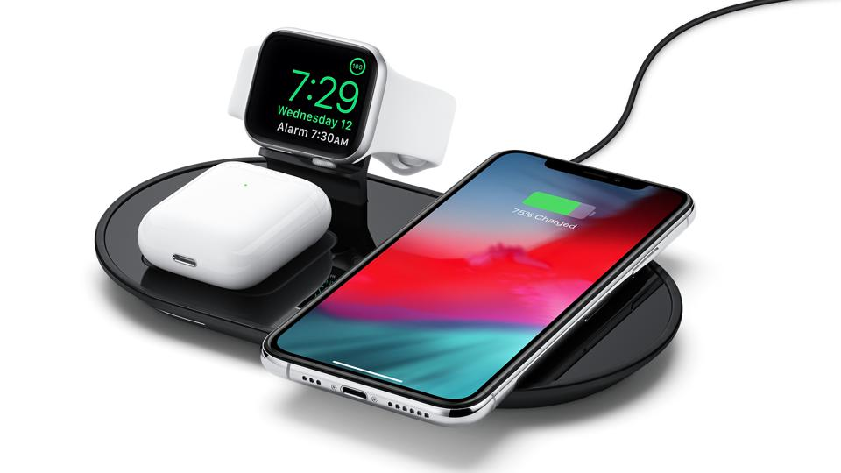
Wireless Power Transfer
Quinn Henry, Cole Hermanson, Nathan Pak, Alex Singh, Dr. Shannon Beck, Dr. Kelly Hughes US Air Force Academy
INTRODUCTION
METHODOLOGY
RESULTS
CONCLUSIONS
OVERVIEW
Wireless power transfer (WPT) has become a prominent feature on most new mobile devices. While it is a convenient feature, the safety of this technology has been largely untested. With this uncertainty, it has been observed that malicious messages can be transmitted through a wireless charger to create negative effects on the receiver (i.e. phone). Additionally, given certain power signatures generated by the communication, predictions on what software is running on the device can be made to a high degree of accuracy.
BIG PICTURE
Our research goals are to serve as a baseline to demonstrate how vulnerable wireless point-to-point communication can be. It can be applied to larger scale versions of this technology such as pacemakers, electric vehicle charging, and satellite communications. This is an ongoing research project conducted by seniors at the Air Force Academy with the intention of finding the extent of which this technology can be exploited and potential ways the threat can be countered.
SNOOPING
Oscilloscope:
An adversarial coil was placed between the transmitter and receiver and voltage across the coil was read with an oscilloscope. Voltages could then be interpreted by hand or Python to output a series of 1’s and 0’s representing Qi message.
Qi Sniffer:
$1000 device that automatically reads all Qi messages between a transmitter and receiver. Provided software allows raw data to be observed like Wireshark. Information is organized by the phase of the Qi messaging protocol the communication is currently in.
Fingerprinting and Analysis:
Python was used to interpret raw data using the Qi wireless power standard. This provides identifying information about the device. This information also allows for prediction about what software the phone is running to be made.
HIJACKING
Proof of Concept:
Initially, a standard wave was created using a waveform generator, and that waveform was sent across the adversarial coil. When read from the oscilloscope, a “0101” message was observed, indicating that the injected waveform was injected into the Qi message.
Malicious Injection:
ChatGPT was used to generate a specific waveform representing a Qi message. The Qi encoding process was described to the AI and a Python code was generated that transforms it into a .csv file. The .csv is then placed on the waveform generator for the waveform to be sent across the adversarial coil.
DEFENSE
Linear Feedback Shift Register Encryption (LSFR):
Encryption was identified as the best method to secure messages sent between the transmitter and receiver. Prevents both snooping and hijacking. LSFR was identified as a lightweight encryption speed that could ensure security while maintaining a sufficient speed to preserve power output. MATLAB was used to create a simulation that acts as a proof of concept for this encryption scheme.
SNOOPING:
This attack variation allows for the collection of key information from the communication between a device and a transmitter. Our team was able to determine the manufacturer, the charge status, a unique serial number, and plot the power the device was receiving over time. The results are consistent with our research. We expected devices to receive less power and for power inputs to be more consistent the closer they are to full battery. This was confirmed from 16 signatures taken from two devices on different operating systems.
Based on our experience to date conducting the final project, the following observations can be made:
The Qi protocol is vulnerable to being used as a method of collecting intelligence.
Devices on a wireless charger can be vulnerable to hijacking and snooping attacks, as demonstrated through re-creating prior research.
One way to prevent attacks while retaining speed is to use a lightweight encryption method such as LSFR
While software predictions can be made, they will not always be accurate. University of Tennessee research achieved 94% accuracy.
Our injection method may not always perform as intended for the Qi communication due to limitations in the waveform generator. Qi communications are faster than the waveform generator can inject.
Future Plans
Based on the final project experience this year, the following is planned for further research on this topic:
Creating a more accurate method of predicting what software is running on the device.
Expand established vulnerabilities to similar WPT technologies such as Bluetooth, lasers, optics, RFID, and LiFi.
Fig. 1.
Transmitter communicates wirelessly with receiver.
Adversarial coil can be placed between the
devices to snoop
information or inject
malicious code.
Fig. 3. Lab setup to read Qi messages between transmitter and receiver and display information on oscilloscope.
Fig. 4. This graph represents an iPhone 14 at full battery. It shows the manufacturer and serial number collected via the Qi sniffer and the power it received over a 30 second period.
HIJACKING:
Successful injection of Qi Packets have been observed using both the oscilloscope and the Qi sniffer. Our Python code allows for the generation of a random message preamble to inject the message at random intervals. It also allows for the input of a Qi message in hexadecimal format that can be translated to voltage over time to be read by a device.
BACKGROUND
This research is part of an ongoing effort by the National Reconnaissance Office (NRO) to defend their assets which communicate through the medium of wireless power transfer. Eventually, they would like to see how this research can be applied to Bluetooth, RFID, lasers, and optics objects in space that the agency uses for surveillance.
Our current research focuses on the Qi protocol and implementation of WPT which is found in phones, watches, and other devices that wirelessly transfer.
DISCLAIMER
The views expressed in this presentation are those of the authors and do not necessarily reflect the official policy or position of the United States Air Force Academy, the Air Force, the Department of Defense, or the U.S. Government.
Fig. 5. A waveform generated by the Python code. It represents a control error packet of negative value. This malicious message means that the phone is requesting a decrease of the Primary Cell (coil) current from the transmitter.
Fig. 2. The Department of Defense (DoD) works closely with the NRO with all matters relating to intelligence gathering.

